Slide 1

Fingerprint Based Biometric Attendance System
Presented by
Projapoti Roy
Roll:1607041
Sharia Wasika Aditi
Roll:1607109

Slide 2
Introduction to our system

Slide 3


Slide 4
Features
Fingers Enrollment
Taking Attendance
Attendance details transferred to memory and calculated in Excel sheet.

Slide 5
Enrollment

Slide 6
When the students want to enroll their fingers, they have to press key ‘B’ and then lcd asks for the ID where they want to store their fingers. With the help of key ‘C’ & ‘D’ they can select their IDs and then have to press ‘#’ to proceed with selected ID.
We have used Fingerprint module to identify a true person by taking his/her finger input in the system.In the enrollment stage, all the students have to register their fingers against their id numbers. To register,they have to select their individual ID and then place finger on the Fingerprint Module for enollment.

Slide 7
The process of enrolling is actually combined by some internal processes in the Fingerprint Module.
Image Acquisition
Image Enhancement
Edge Detection
Image Acquisition: Fingerprint Image Acquisition is considered to be the most critical step in an automated fingerprint authentication system, as it determines the final fingerprint image quality which has a drastic effect in the overall system. Automated fingerprint verification systems use live scan digital images of fingerprints from a fingerprint sensor.

Slide 8
Image Enhancement: Image Enhancement improves the clarity of ridge and valley structures in the fingerprint images. Histogram equalization method is used for image enhancement.
Edge Detection: The purpose of edge detection is to significantly reduce the amount of data found in a fingerprint image and leave only the most important information. Edge detection works by finding points on an image where the gray scale of value changes greatly between pixels. They are many operators used for detecting the edges. The operators are Prewitt, Laplacian, Sobels, Robertson operators.

Slide 9
Attendance

Slide 10
To give Attendance,the students have to press key ‘A’. Then LCD asks for placing finger on the fingerprint module. Then the fingerprint is captured again and the extracted features compared with the template in the database to determine a match before attendance is made. If the fingerprint is not matched lcd shows a message ‘Finger not found’ and if matched, the system will check if matching (student check in time) is made within the first 15 minutes of the class time. If so, the student will be considered as present otherwise it will be a late attendance for him/her.

Slide 11
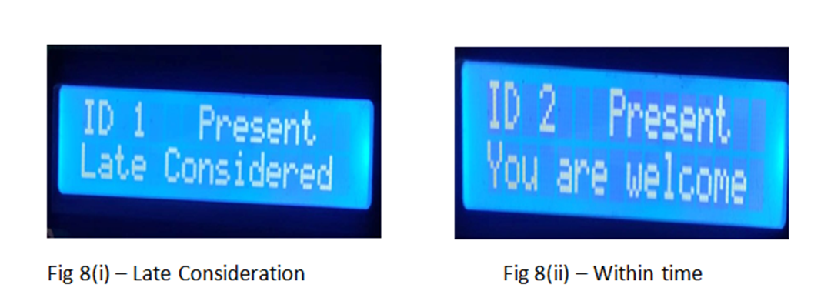
The following messages are shown in LCD display after giving attendance –

Slide 12
Data Transfer and calculation in Excel file

Slide 13
Through SD card module all the data records will be transferred to an Excel file. Further calculations on the attendance data will be performed on the excel sheet. We have calculated total number of classes as well as number of students present in every class through Unique Count and Count functions. We also have calculated total number of attendance of each students through Countif and Countifs functions and pecentage of attendance.

Slide 14
Relationship Graphs

Slide 15
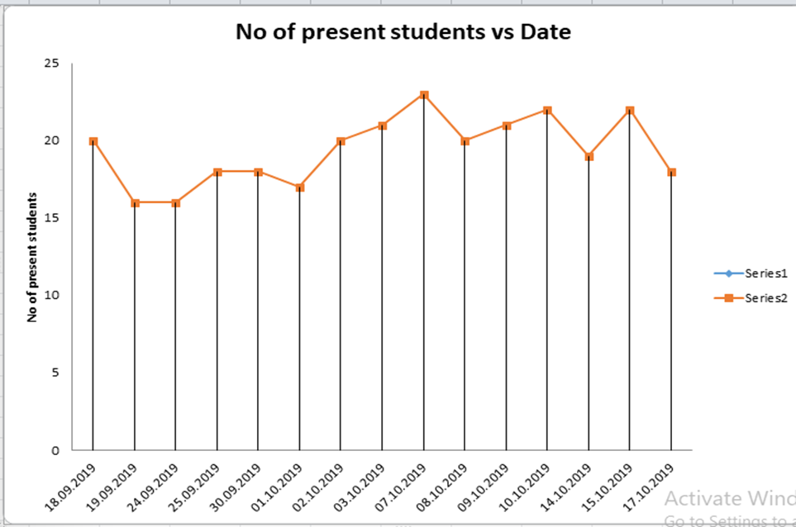

Slide 16
89,526,124$
100%
That’s a lot of money
And a lot of users
Total success!

Slide 17
OUR PROCESS IS easy
First
Last
Second

Slide 18
LET’S REVIEW SOME concepts
Yellow
Is the color of gold, butter and ripe lemons. In the spectrum of visible light, yellow is found between green and orange.
Blue
Is the colour of the clear sky and the deep sea. It is located between violet and green on the optical spectrum.
Red
Is the color of blood, and because of this it has historically been associated with sacrifice, danger and courage.
Yellow
Is the color of gold, butter and ripe lemons. In the spectrum of visible light, yellow is found between green and orange.
Blue
Is the colour of the clear sky and the deep sea. It is located between violet and green on the optical spectrum.
Red
Is the color of blood, and because of this it has historically been associated with sacrifice, danger and courage.

Slide 19
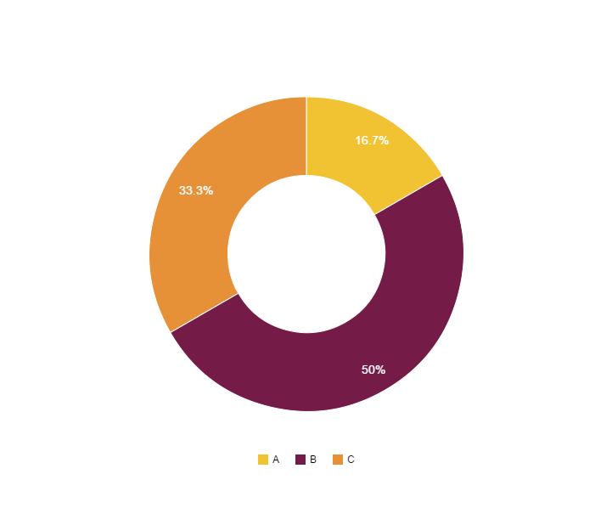
You can copy&paste graphs from Google Sheets

Slide 20
Place your screenshot here
MOBILE project
Show and explain your web, app or software projects using these gadget templates.

Slide 21
Place your screenshot here
TABLET project
Show and explain your web, app or software projects using these gadget templates.

Slide 22
Place your screenshot here
DESKTOP project
Show and explain your web, app or software projects using these gadget templates.

Slide 23
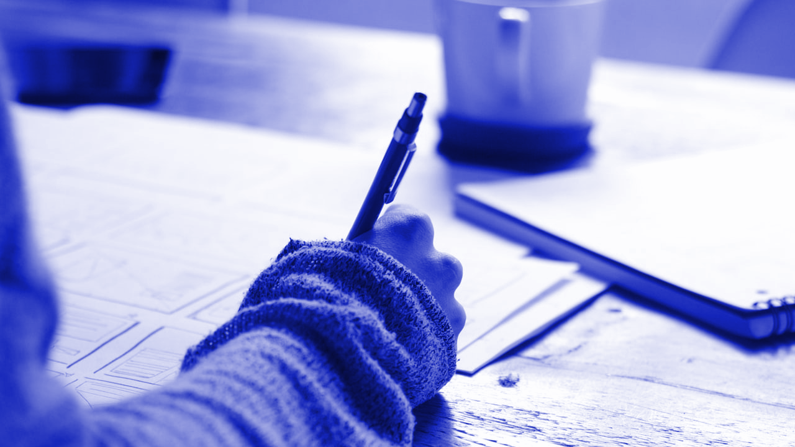
thanks!
ANY QUESTIONS?
You can find me at:
@username
user@mail.me

Slide 24
Credits
Special thanks to all the people who made and released these awesome resources for free:
Presentation template by SlidesCarnival
Photographs by Unsplash

Slide 25
Presentation design
This presentations uses the following typographies and colors:
Titles & text: Raleway
Handwritten font: Homemade Apple
You can download the fonts on these pages:
https://www.fontsquirrel.com/fonts/raleway
https://www.fontsquirrel.com/fonts/homemade-apple
You don’t need to keep this slide in your presentation. It’s only here to serve you as a design guide if you need to create new slides or download the fonts to edit the presentation in PowerPoint®

Slide 26
SlidesCarnival icons are editable shapes.
This means that you can:
Resize them without losing quality.
Change fill color and opacity.
Isn’t that nice? :)
Examples:

Slide 27
Now you can use any emoji as an icon!
And of course it resizes without losing quality and you can change the color.
How? Follow Google instructions https://twitter.com/googledocs/status/730087240156643328
😉
✋👆👉👍👤👦👧👨👩👪💃🏃💑❤😂😉😋😒😭👶😸🐟🍒🍔💣📌📖🔨🎃🎈🎨🏈🏰🌏🔌🔑 and many more...

Slide 28

Free templates for all your presentation needs
For PowerPoint and Google Slides
100% free for personal or commercial use
Ready to use, professional and customizable
Blow your audience away with attractive visuals

